Slide 1


Hardware Connection based Serial Communication
LÊ TRỌNG NHÂN
trongnhanle@hcmut.edu.vn
trongnhanle85@gmail.com

Slide 2
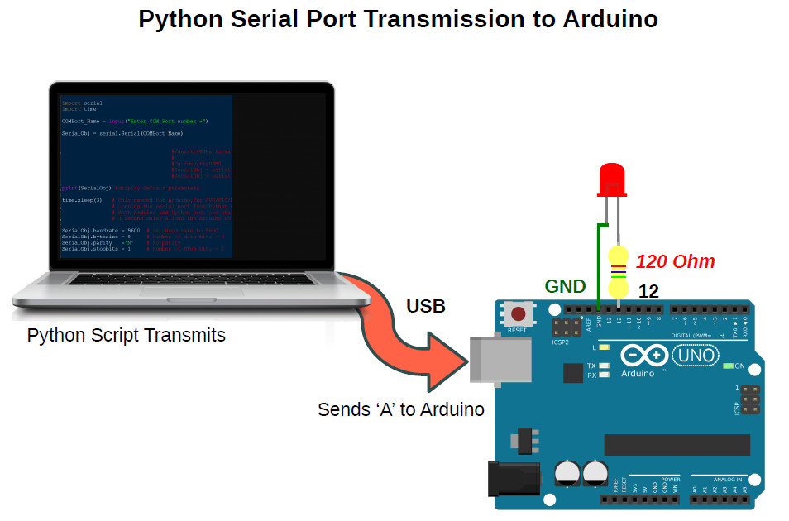
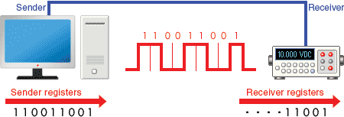
What is Serial Communication?
Serial communication is a communication method that uses one or two transmission lines to send and receive data, and that data is continuously sent and received one bit at a time.
All programmable devices have at least one serial: PC, Smartphone, Tablets, Arduino Boards

Slide 3
Part 1: Send Commands To Hardware

Slide 4
Step 1: Install pyserial
pip install pyserial
print("Sensors and Actuators") import time import serial.tools.list_ports

Slide 5
Step 2: Open the port
try: ser = serial.Serial(port=“COMx”, baudrate=115200) except: print("Can not open the port")
In windows: check the port name in Device Manager/Ports
In MAC/Linux: ls /dev/tty*

Slide 6
Step 3: Send A Command
def sendCommand(cmd): ser.write(cmd.encode())

Slide 7
Step 4: Testing the Program
Command | Device
2 | Turn on LED
3 | Turn off LED
4 | Turn on Relay
5 | Turn of Relay
while True: print("Testing commands") sendCommand("2") time.sleep(2) sendCommand("3") time.sleep(2) sendCommand("4") time.sleep(2) sendCommand("5") time.sleep(2)

Slide 8
Full program
print("Sensors and Actuators") import time import serial.tools.list_ports try: ser = serial.Serial(port="COM8", baudrate=115200) except: print("Can not open the port") def sendCommand(cmd): ser.write(cmd.encode()) while True: print("Testing commands") sendCommand("2") time.sleep(2) sendCommand("3") time.sleep(2) sendCommand("4") time.sleep(2) sendCommand("5") time.sleep(2)

Slide 9
Part 2: Receive Sensory Data

Slide 10
Receive and Process Data
mess = ""
def processData(data):
data = data.replace("!", "")
data = data.replace("#", "")
splitData = data.split(":")
print(splitData)
def readSerial():
bytesToRead = ser.inWaiting()
if (bytesToRead > 0):
global mess
mess = mess + ser.read(bytesToRead).decode("UTF-8")
while ("#" in mess) and ("!" in mess):
start = mess.find("!")
end = mess.find("#")
processData(mess[start:end + 1])
if (end == len(mess)):
mess = ""
else:
mess = mess[end+1:]

Slide 11
Request Sensory Data
def requestData(cmd): sendCommand(cmd) time.sleep(1) readSerial()

Slide 12
Testing the Program
while True: requestData("0") time.sleep(2) requestData("1") time.sleep(2)

Slide 13
Exercise 1
Implement the callback message() in mqtt, in order to control a device when mqtt data is received (button on the dashboard is clicked)

Slide 14
Exercise 2
Modify the while True in mqtt.py, in order to request the data from sensor and publish it to the mqtt server

Slide 15
Finalize the LAB
Update your repository in Github

